Slide 1
London Bridge
Presented by
Shadikun nahar sakiba
Id:011153082
Shirajum monira
Id:011153116

Slide 2
Introduction
Our project is London Bridge…
it’s a scenario.
We can see this scenario from every angle .

Slide 3
Individual work
Create right wall
Create cone shape
Create out sider road
Create top roof
Create front wall
Create palace
Create road
Create hanging torus

Slide 4
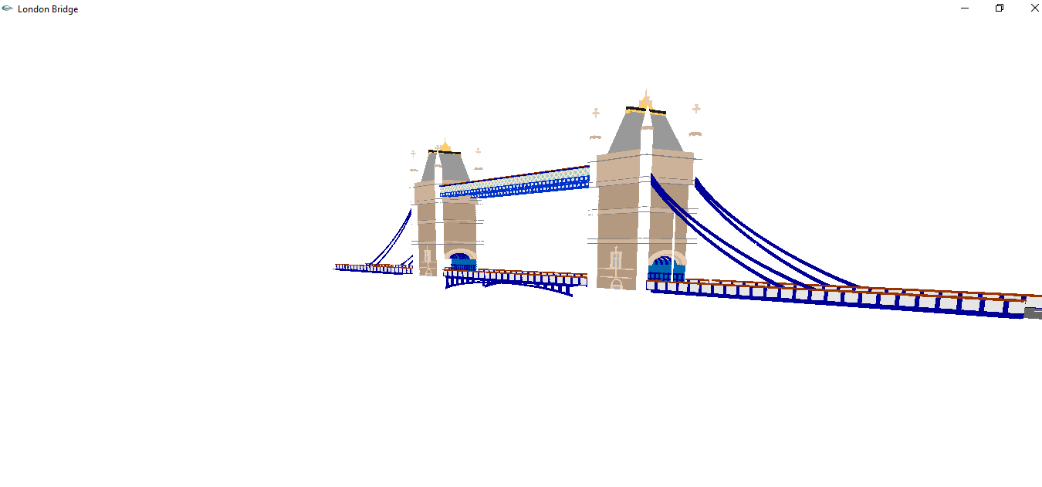
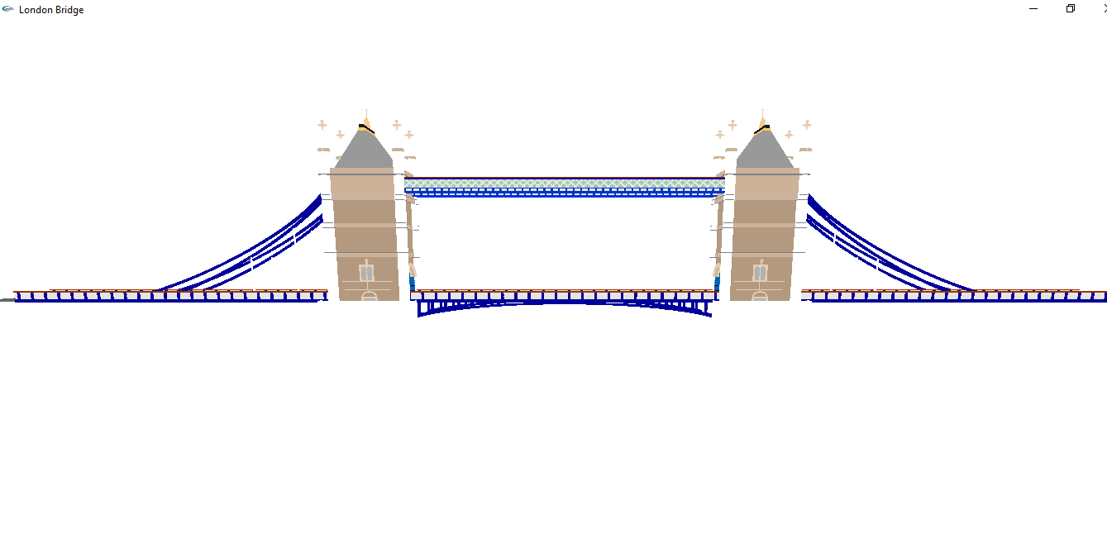
Screenshots

Slide 5
Thank you

